Slide 1
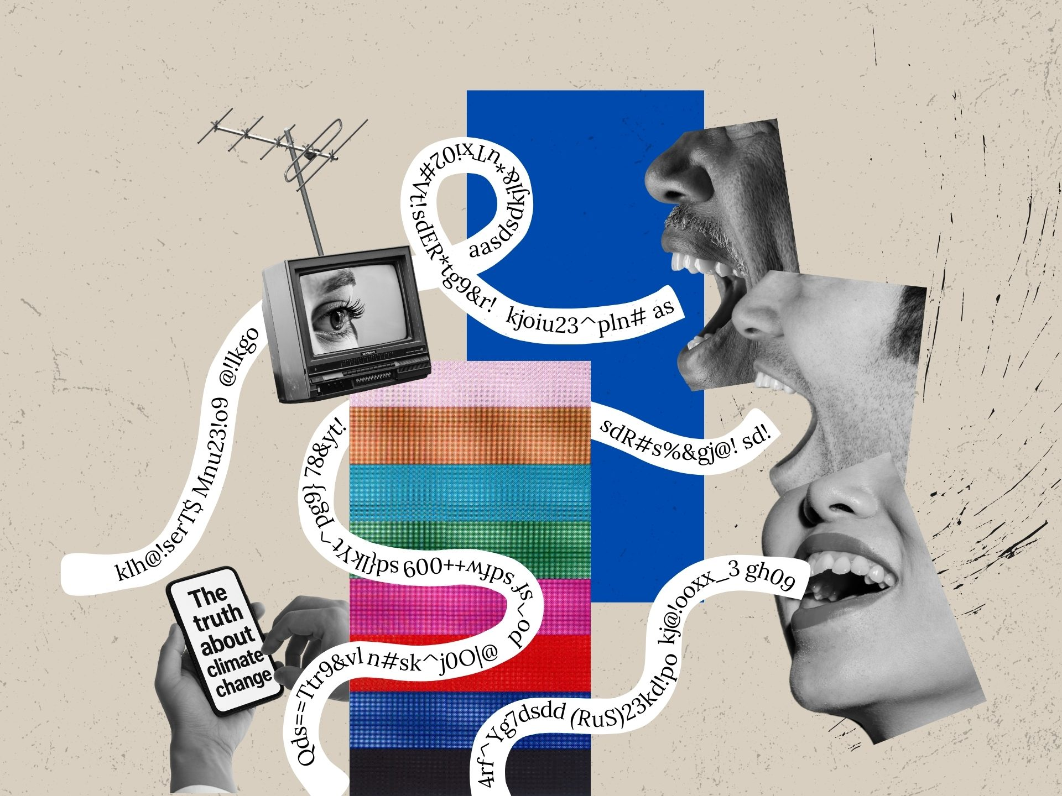
Eric Prebys
FRS-003-009

Slide 2
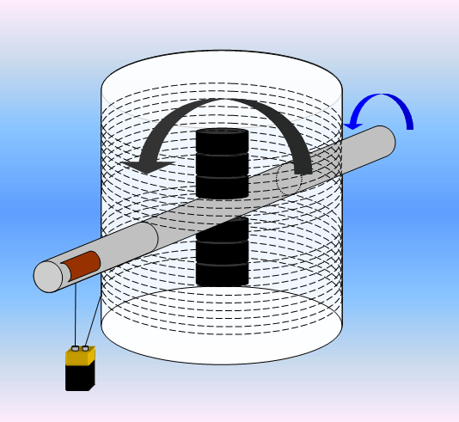
Following up on Mr. Newman
Joe Newman claimed to have developed a motor that put out more mechanical power than in required in electrical power
If true, he could have run it “closed” loop by having it drive a generator, but he never did this
Claimed it wasn’t “perpetual motion” because it was somehow extracting energy from the copper coils.
He became very popular in the media, as evidenced by the video I asked you to watch.
He spent a decade fighting for a patent, even bringing the matter before congress.
In 1989, a judge ordered NBS (now NIST) to test the device.
They determined it was actually a very inefficient motor and the patent was denied.
He died in 2015, still claiming his device worked.

Slide 3
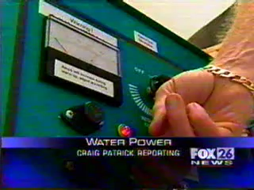
The News Report that Got Me Started…
Variations of this story were reported in multiple news sites in 2006

Slide 4
What a good reporter might have noticed
If you could build a car that runs on water, why would you build a “gas-water hybrid”? Nostalgia?
They used “4 ounces of water”, but how much gas?
Do you have a lot of call to cut through charcoal?
Could it be the Oxygen was combining directly with the Carbon and the charcoal was simply burning itself?
They might have contacted the military to see if the claimed contract negotiation was real.
Spoiler: it wasn’t

Slide 5
The Reality of Aquygen
Nothing magic about making a flame with Hydrogen from electrolysis.
Particularly with a unit the size of an arc-welder.
It’s not a particularly good for cutting or welding, which is why no one does it that way.
This sort of thing has been tried many times before
Google “Brown’s gas” or “Klein’s gas”, for example
There’s no such thing as “HHO”.
It’s a stoichiometric mix of hydrogen and oxygen and it’s very dangerous!
There’s no evidence
As of 2018, Aquygen switched from claiming they could run a car on water to saying it improved gas mileage.
It didn’t
They seem to be gone now

Slide 6
What is Media?
Once it meant:
Newspapers (one or two a day)
Television (major networks had two newscasts a day)
Radio (there have always been all news radio stations)
Now it includes
Websites
YouTube
Podcasts
TikTok
Social media
etc
Literally anyone with a smartphone can publish content that’s available to the entire world.
I’m going to stick to “mainstream media”

Slide 7
Problems with Media and Science
Even exciting science doesn’t sound exciting.
Too much technical jargon
Temptation to simplify and/or sensationalize it can sometimes change the meaning entirely
Poor grasp of basic statistics and statistical significance.
Preliminary results reported as fact
Not understanding the difference between “science” and “technology”
We keep coming back to that
Not everything has two sides!
The only “scoop” in science is a scandal
See examples from last lecture
No significant scientific result has ever been reported first in the media.
Not understanding problems inherent in particular fields.

Slide 8
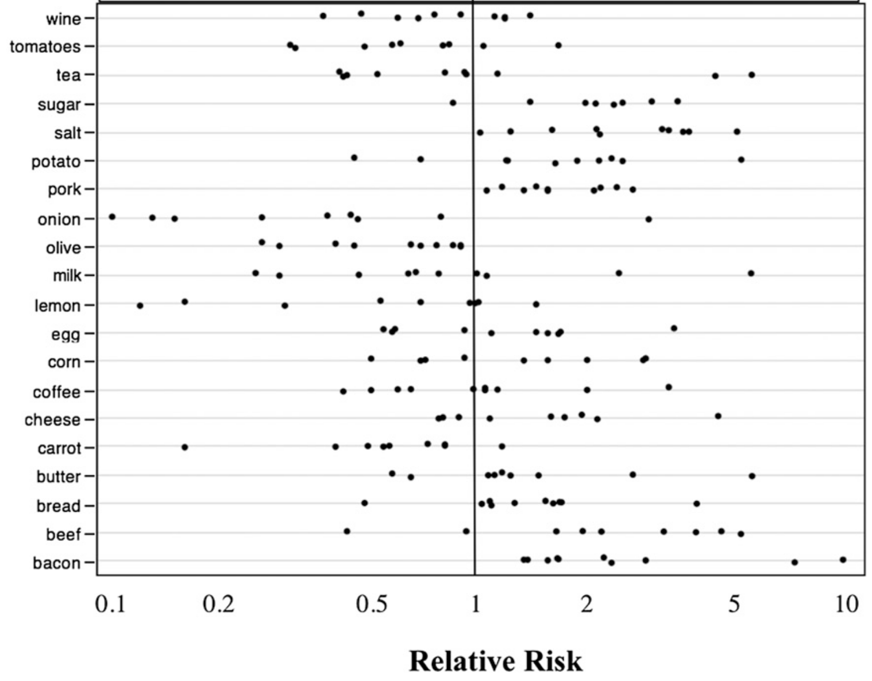
Particularly Hard for Medical Science
An interesting study in 2013* showed the inconsistency of various studies on cancer risks associated with foods.
Reduced Risk
Increased Risk
Newsflash! Milk causes cancer!
Newsflash! Milk prevents cancer!
*Schoenfeld and Ioannidis, "Is everything we eat associated with cancer?” (2013)

Slide 9
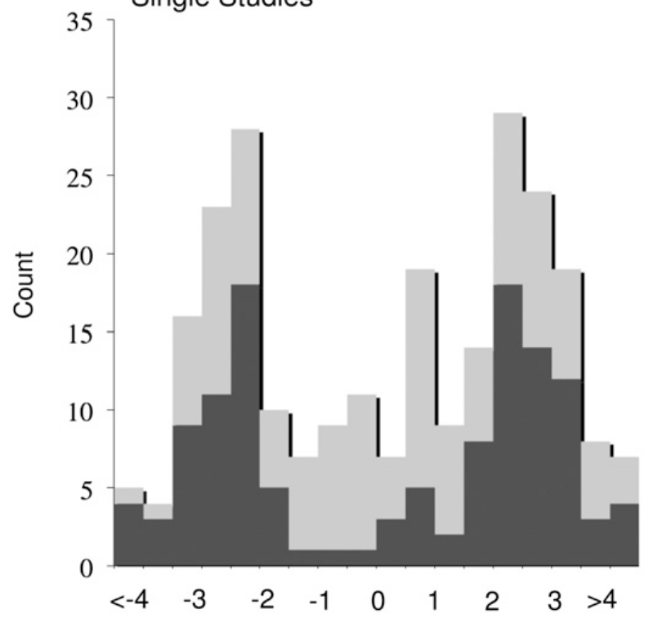
This Also Showed a Strong Publication Bias
Z-factor (effect over error)
Consistent results would be on one side or the other.
Statically distributed null results would peak in the middle.
The only explanation for this is that these are mostly statistically varying results, bu they didn’t publish the null ones.

Slide 10
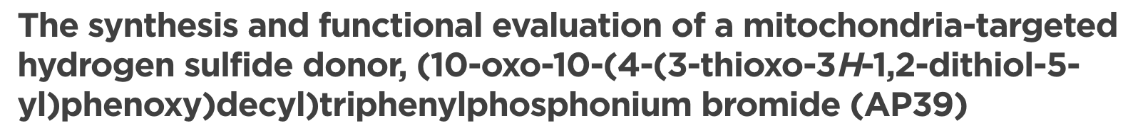
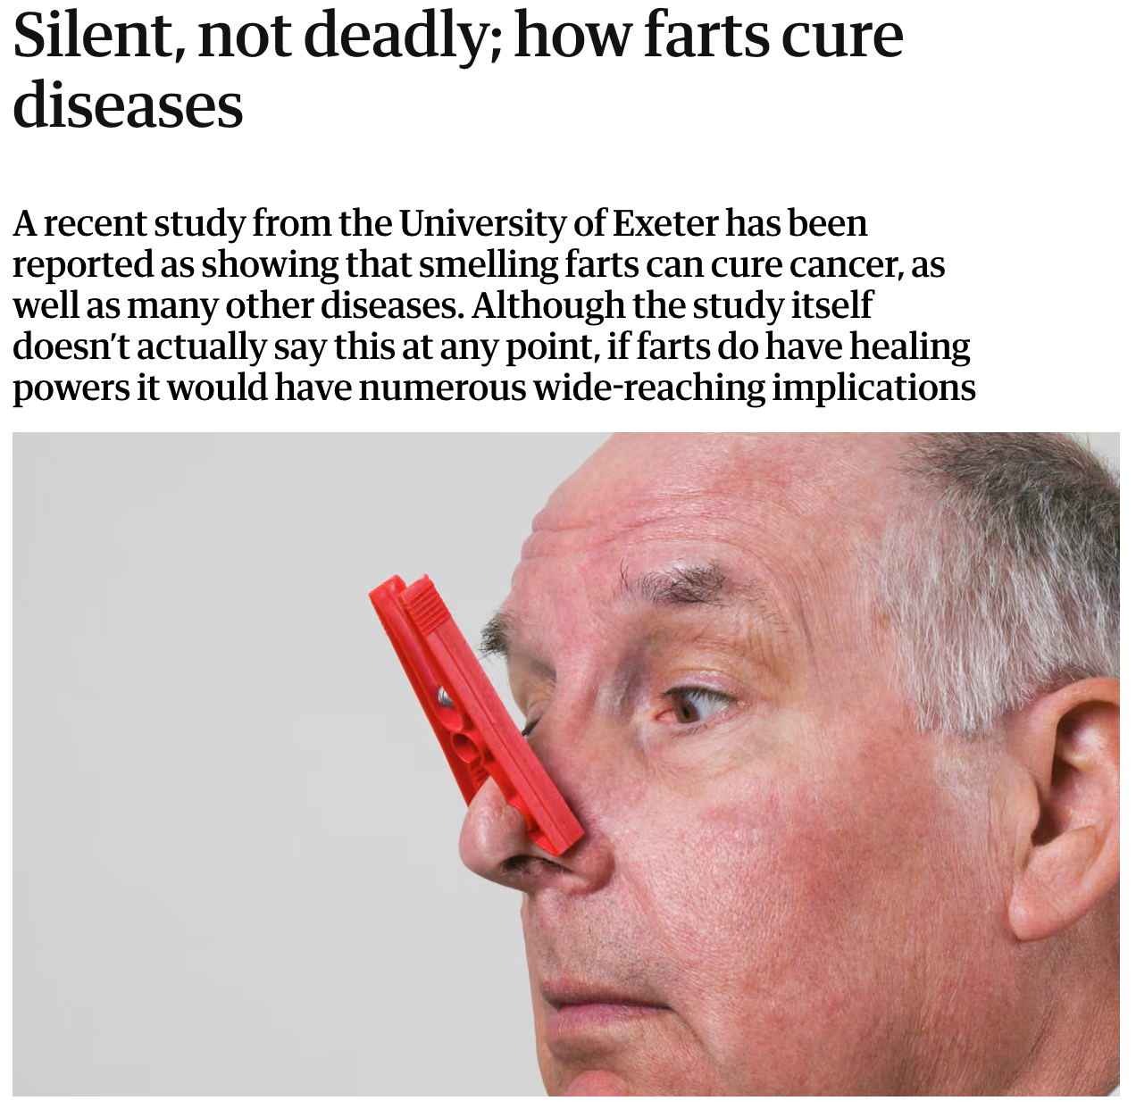
Simplifying Science…..into Nonsense
In 2014, the Journal Medical Chemical Communications published an article with the confusing title
The researchers exposed mitochondria from cells to hydrogen sulfid
They found evidence it could protect them from damage, which is a factor in cancer, stroke, and dementia
How this was widely reported in the media…
This example is from The Guardian!

Slide 11
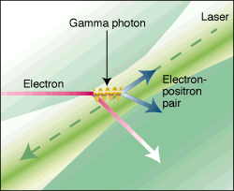
Game of Telephone
Many news articles are based on other articles.
They will usually add material to avoid copyright issues.
This can often change the meaning of the original article.
A personal example…
In the mid-1990s, I was part of a small group working at Stanford that produced electron-positron pairs by bouncing a powerful laser off of the SLAC electron beam and then allowing it to re-interact with the laser*.
While fully consistent with the laws of physics this was the first time matter had been created from pure light.
That’s kind of cool, so it generated an unusual amount of interest in the popular press, including an excellent article in the New York Times.
To this day, this is my fourth most cited paper (1248), behind three others from huge collaborations.
*Phys. Rev. Lett., Vol. 79, p. 1626 (1997)

Slide 12
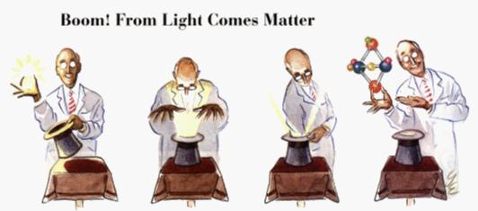
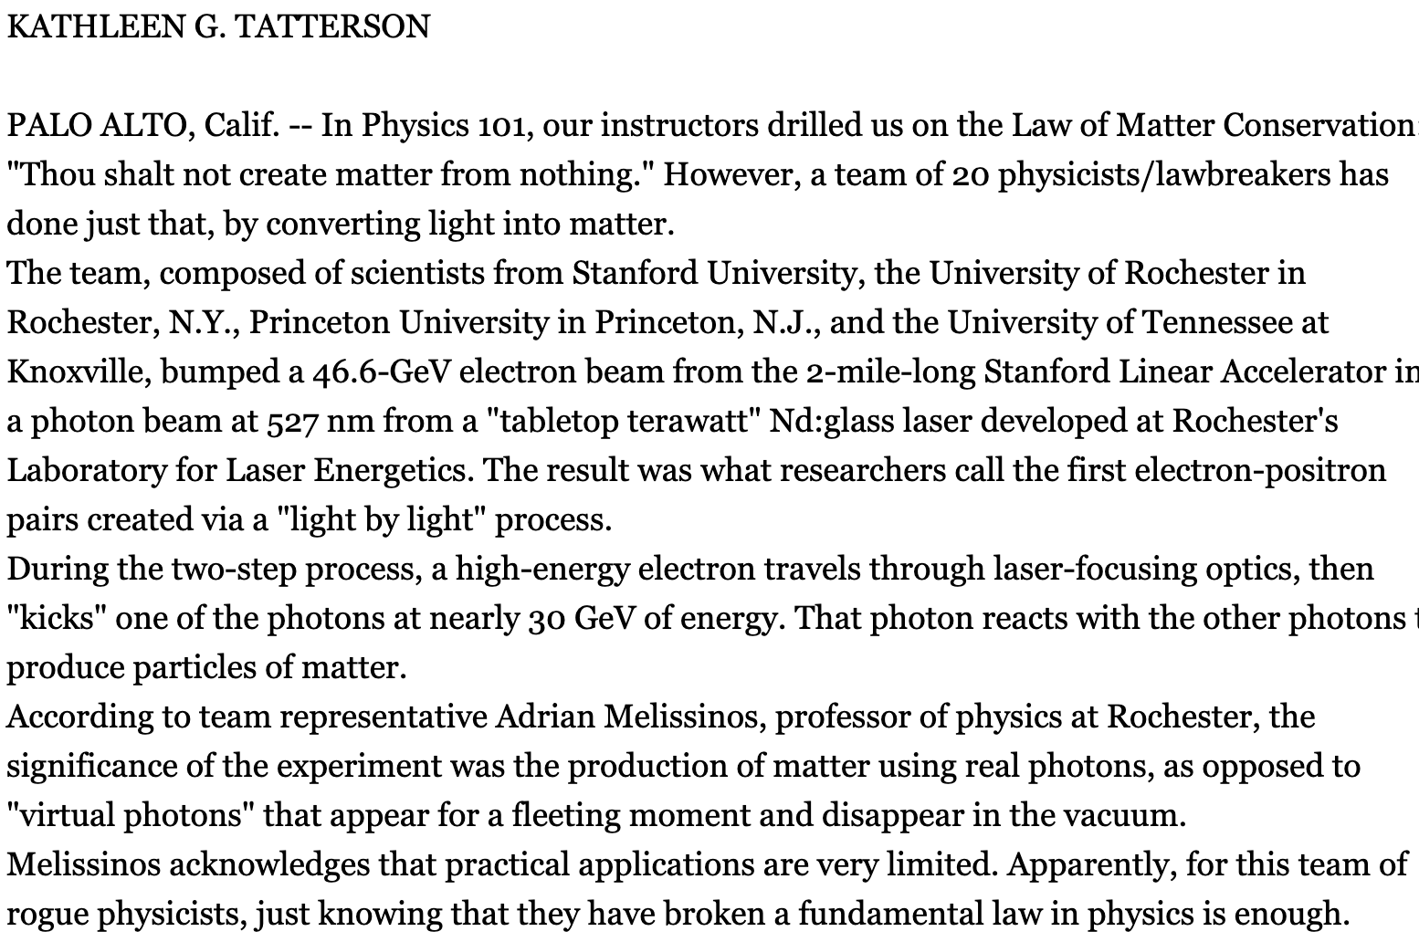
Where it went…
The NYT article inspired MANY other articles, all of which tweaked it a bit.
It finally arrived at this article in the Photonics Spectra trade magazine, which gets a whole lot wrong.
The lesson: Always find the original source!

Slide 13
Being an Expert in One Field Doesn’t Make you an Expert in All
As second definition of “Stockholm Syndrome” is that when someone wins a Nobel Prize in Physics, Chemistry, or Medicine, they start to share their opinion on everything. Examples:
Brian Josephson, who shared the 1973 Nobel Prize in Physics for the discovery of revolutionary quantum effects believed in homeopathy and ESP.
William Schockley, who shared the 1956 Nobel Prize for the invention of the transistor devoted the later years of his live to pushing his White Supremacist and Eugenics views.
Kary Banks Mullis, who shared the 1993 Nobel Prize for the polymerase chain reaction, crucial to DNA testing went on to push climate change denial and HIV/AIDS “skepticism”.
Linus Pauling, who won a Nobel Prize in Chemistry in 1954 and a Nobel Peace Prize in 1962 (for nuclear activism) pushed (with no evidence) his theory that massive doses of vitamin C can cure anything.
Obviously, when people like this talk, the press listens!

Slide 14
Parting Words
As always, when you hear something on the news, do your best to find the original sources.
If it sounds too good to be true, it probably is.

